Slide 1

Object Location via MBot Ranger
Margarita Gubanova, Jennifer Ribeiro, Karan Machado
Notes:
Jenny : Title
Say own names

Slide 2
Objective
Robot identifies objects randomly placed throughout room as it randomly explores
Makes a noise and flashes lights when object is found
The idea behind this was to help those visually impaired locate objects with the aid of the robot
Label object on map
This is so later on (if time allowed) the robot could give a path to the object for the user
Notes:
Jenny

Slide 3
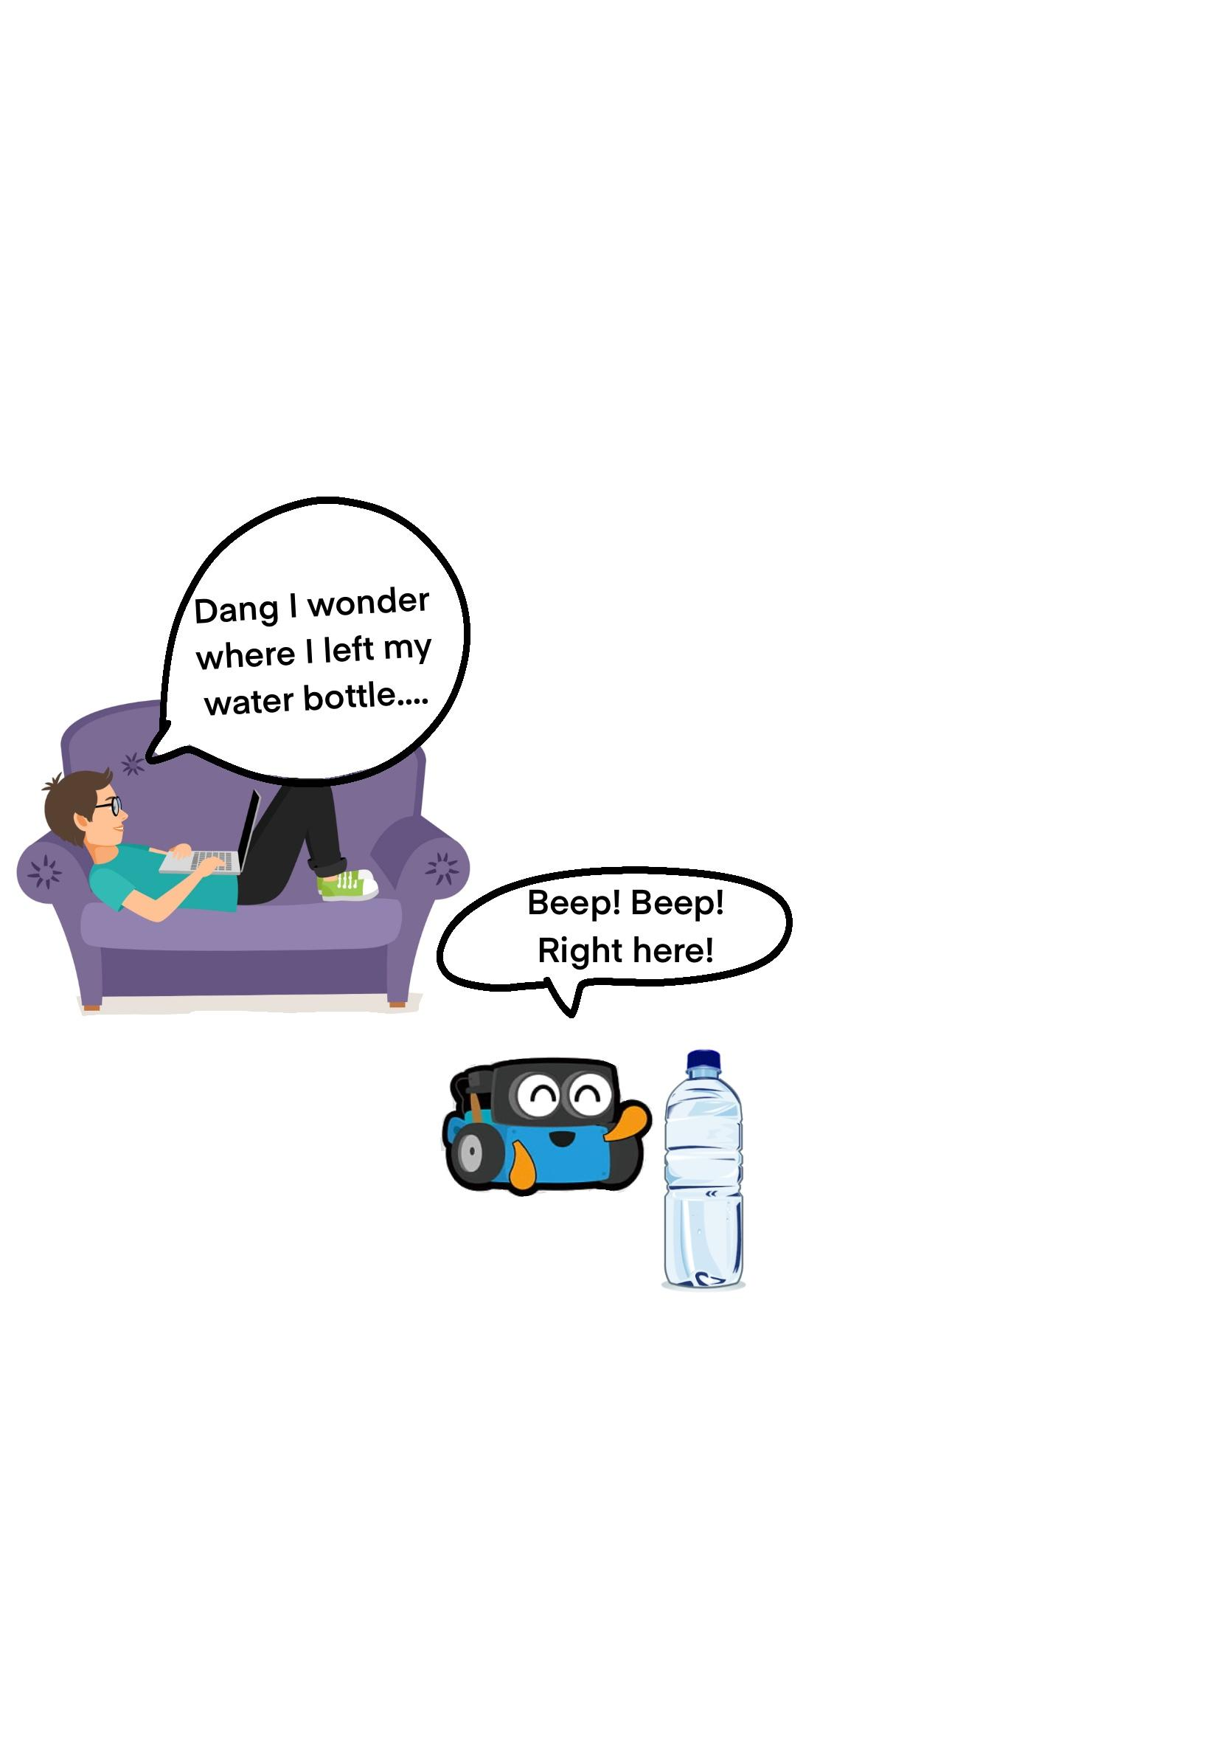
Never Worry Again!
Notes:
Jenny

Slide 4
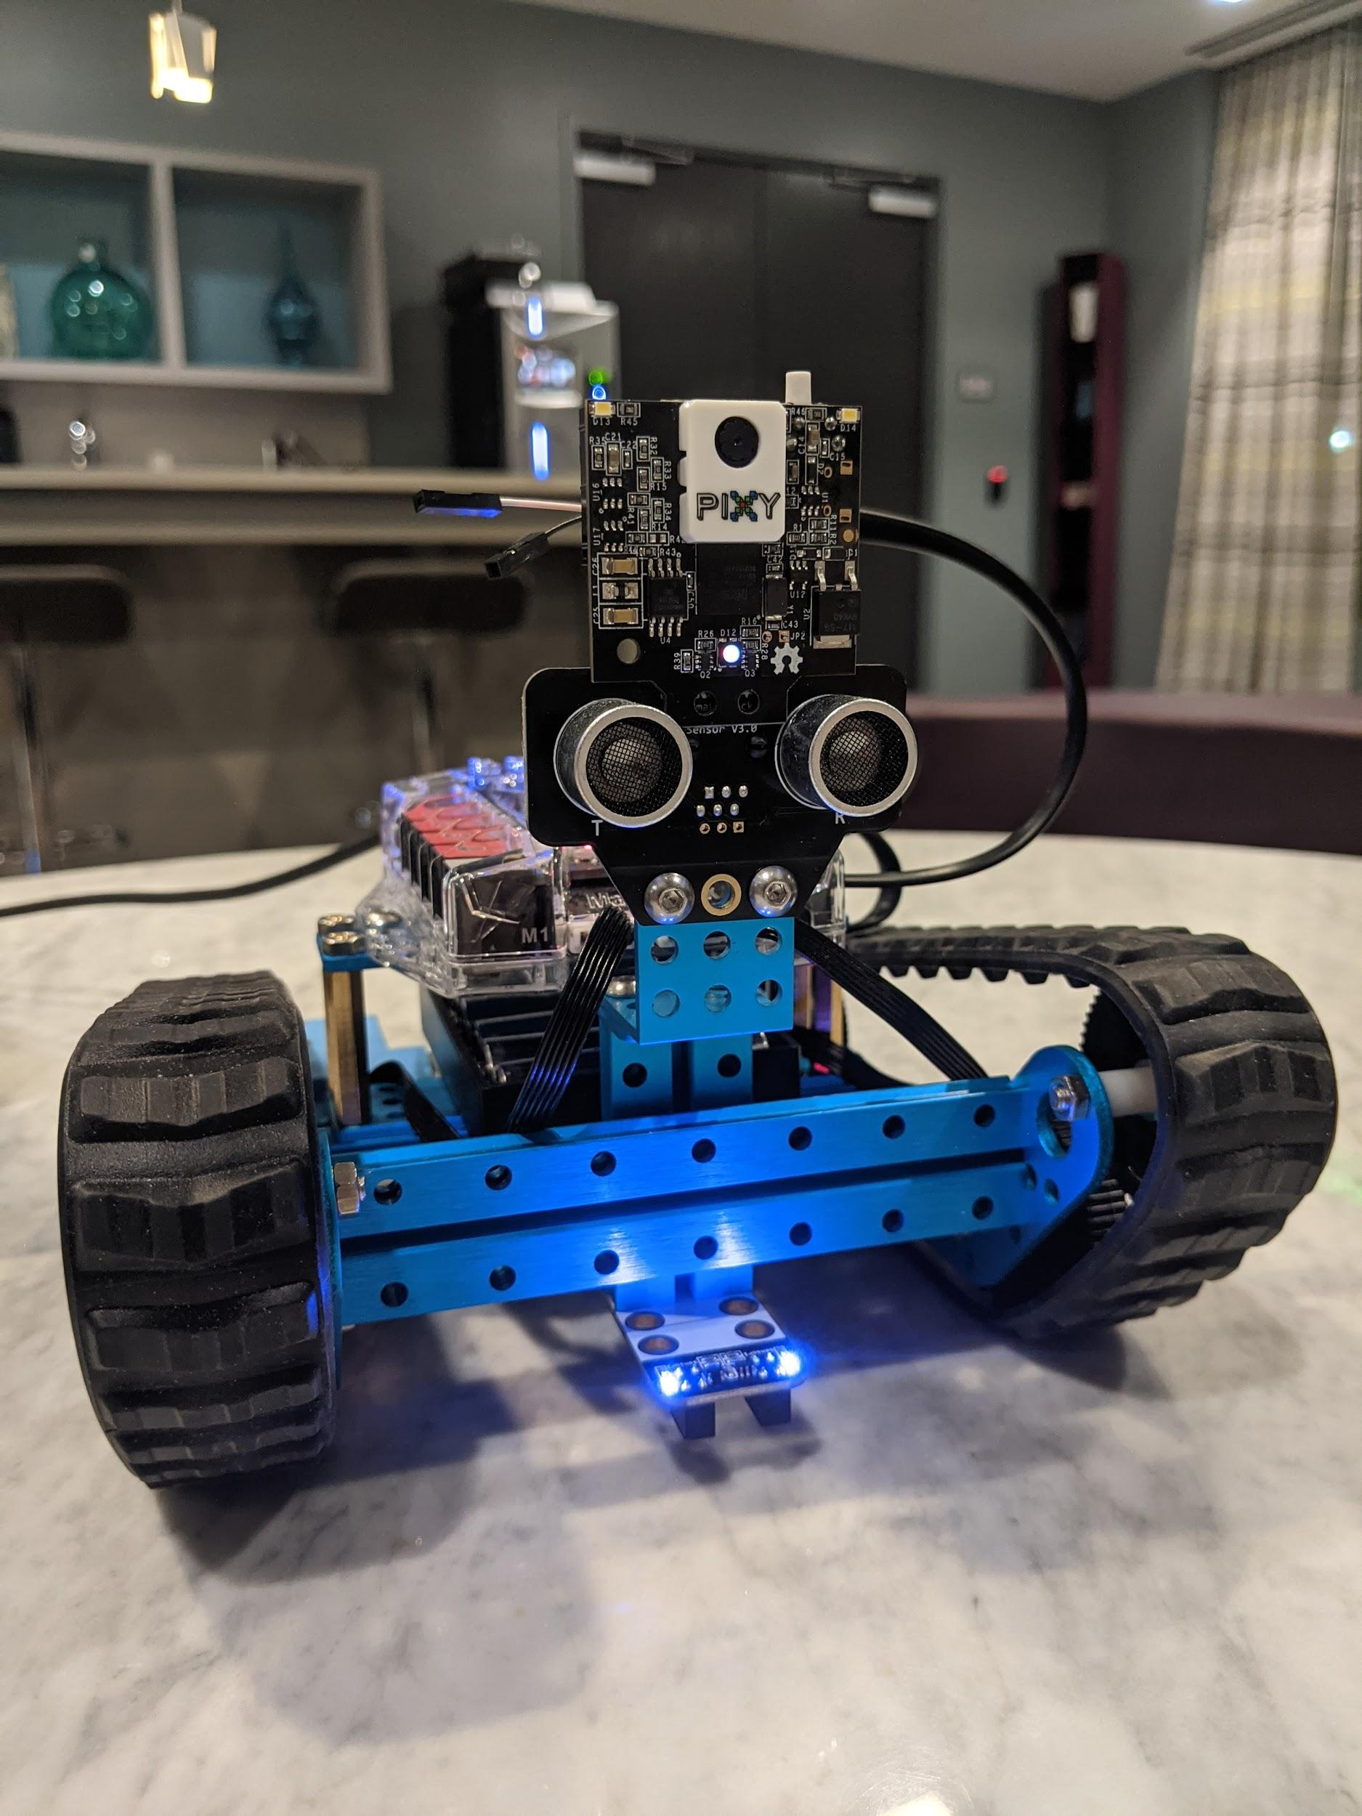
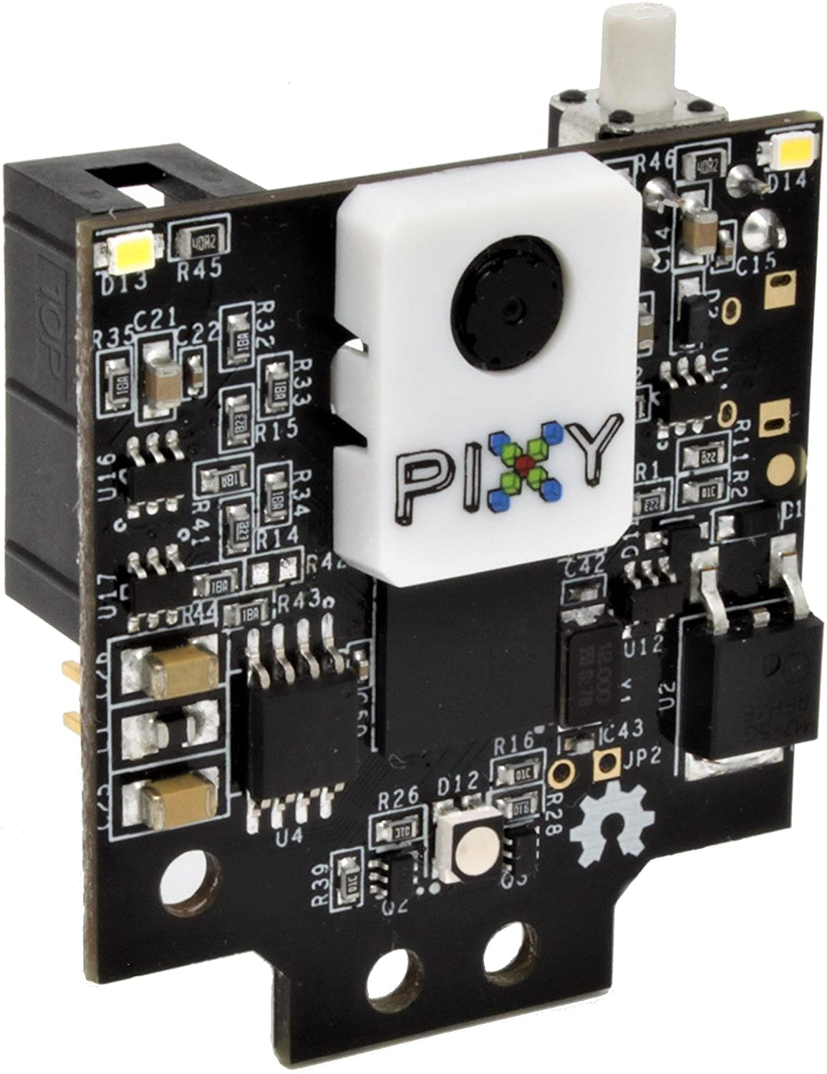
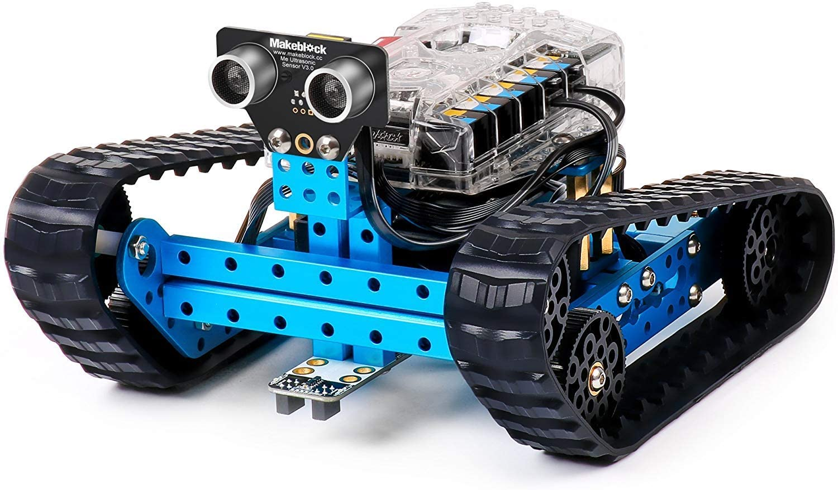
The Set Up
MBot ranger kit with Pixy Cam Attached
Notes:
Mar

Slide 5
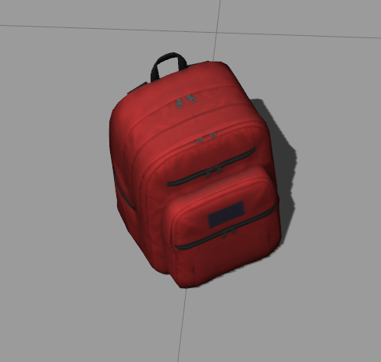
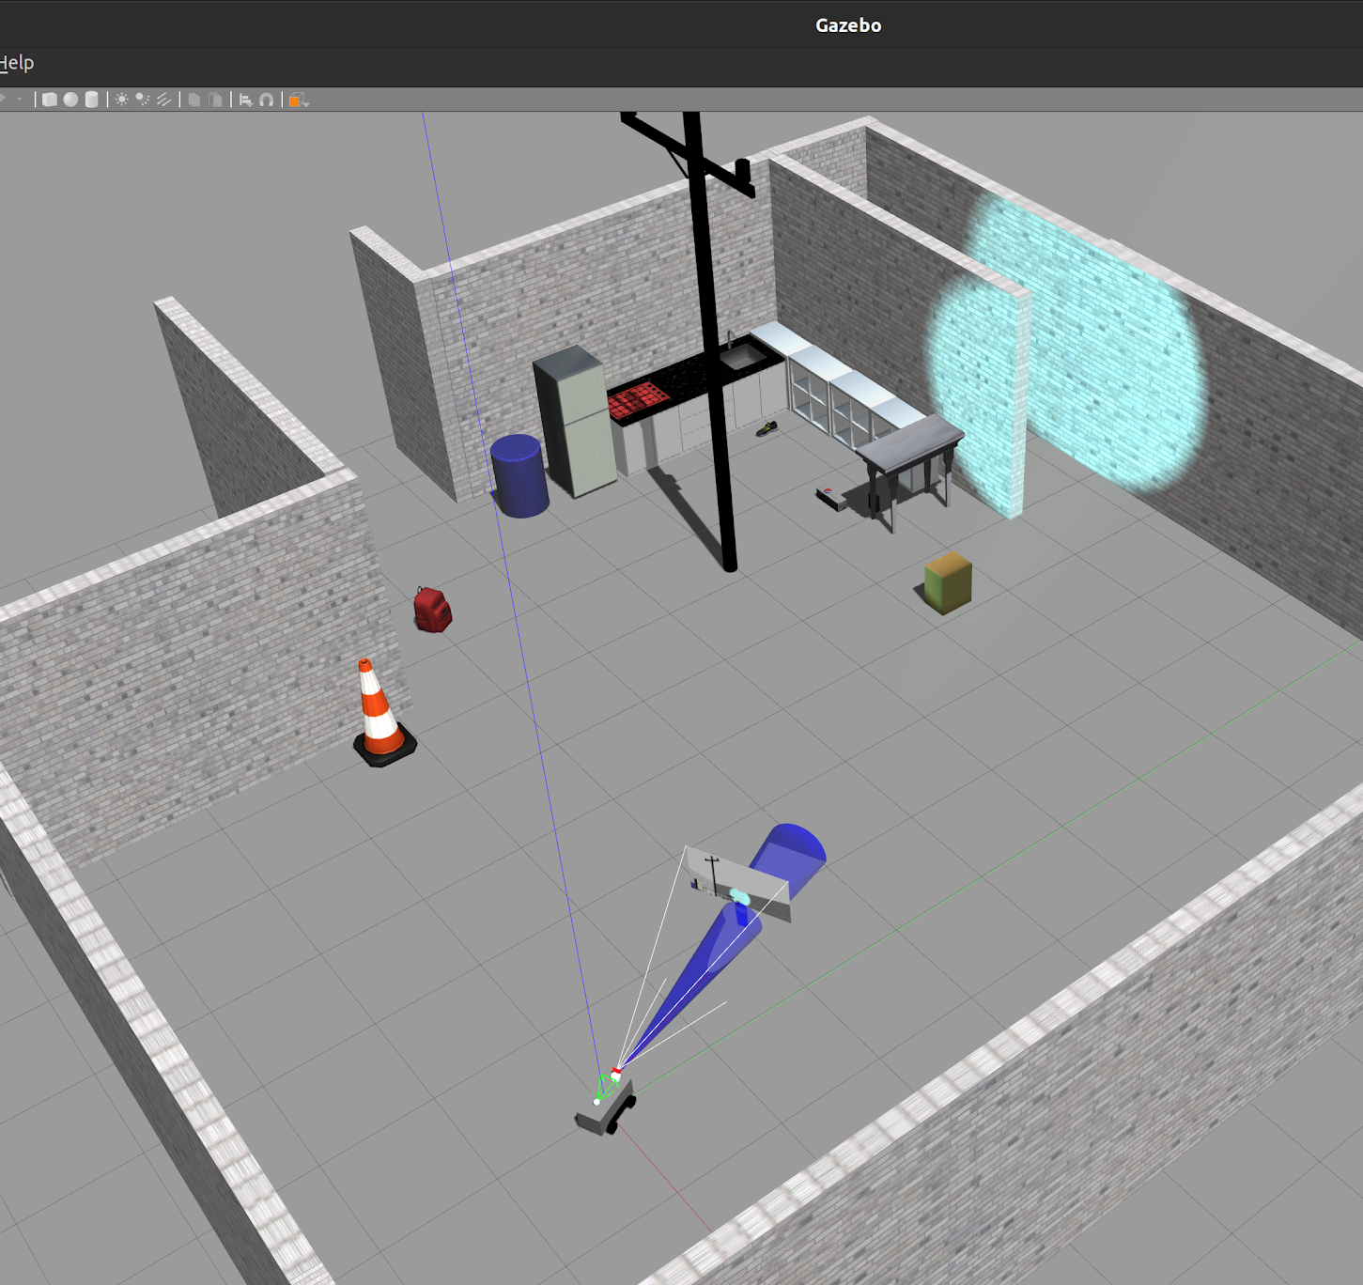
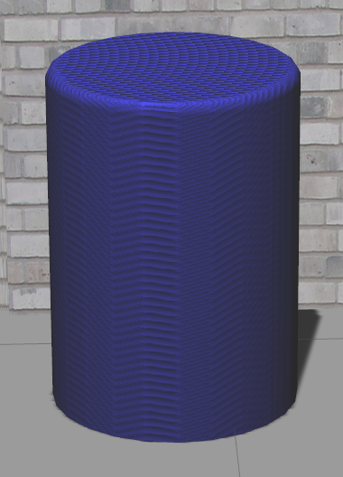
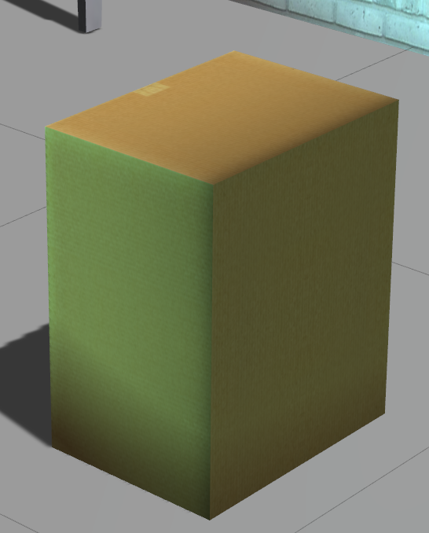
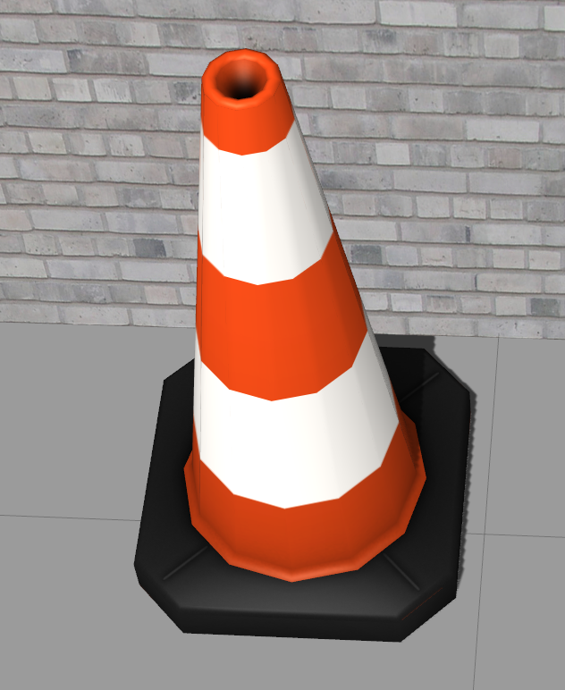
Sim Environment
Notes:
Mar

Slide 6
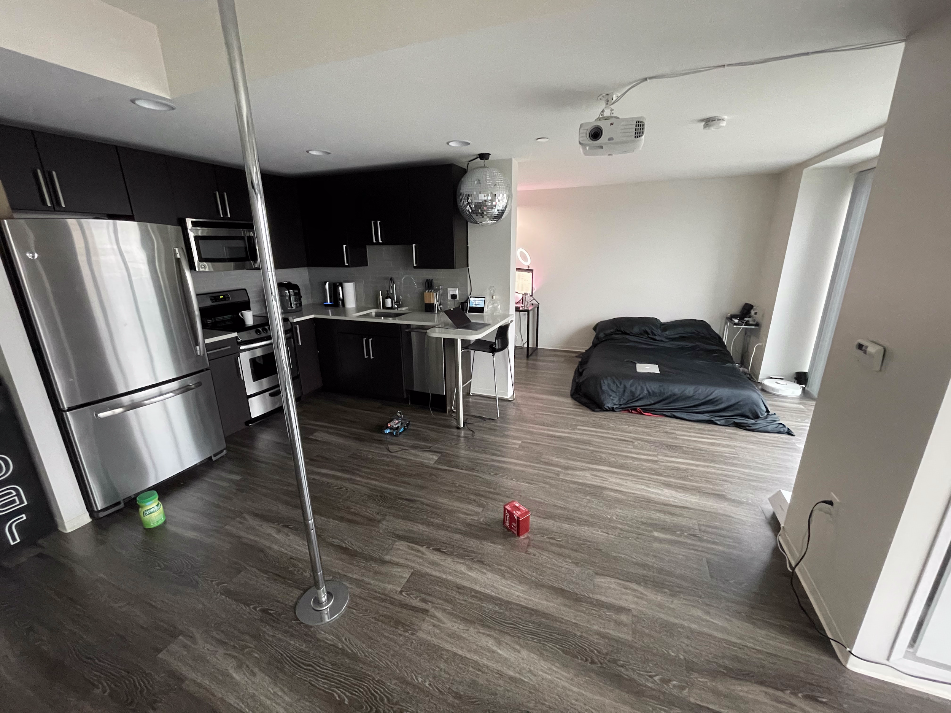
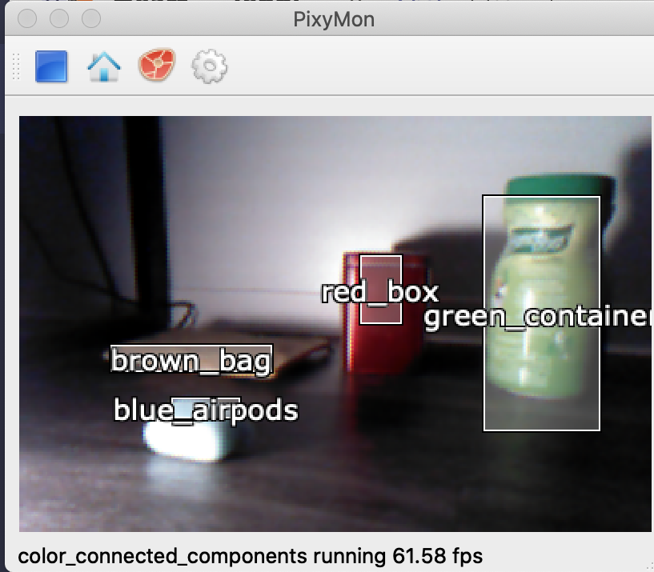
Apartment

Slide 7
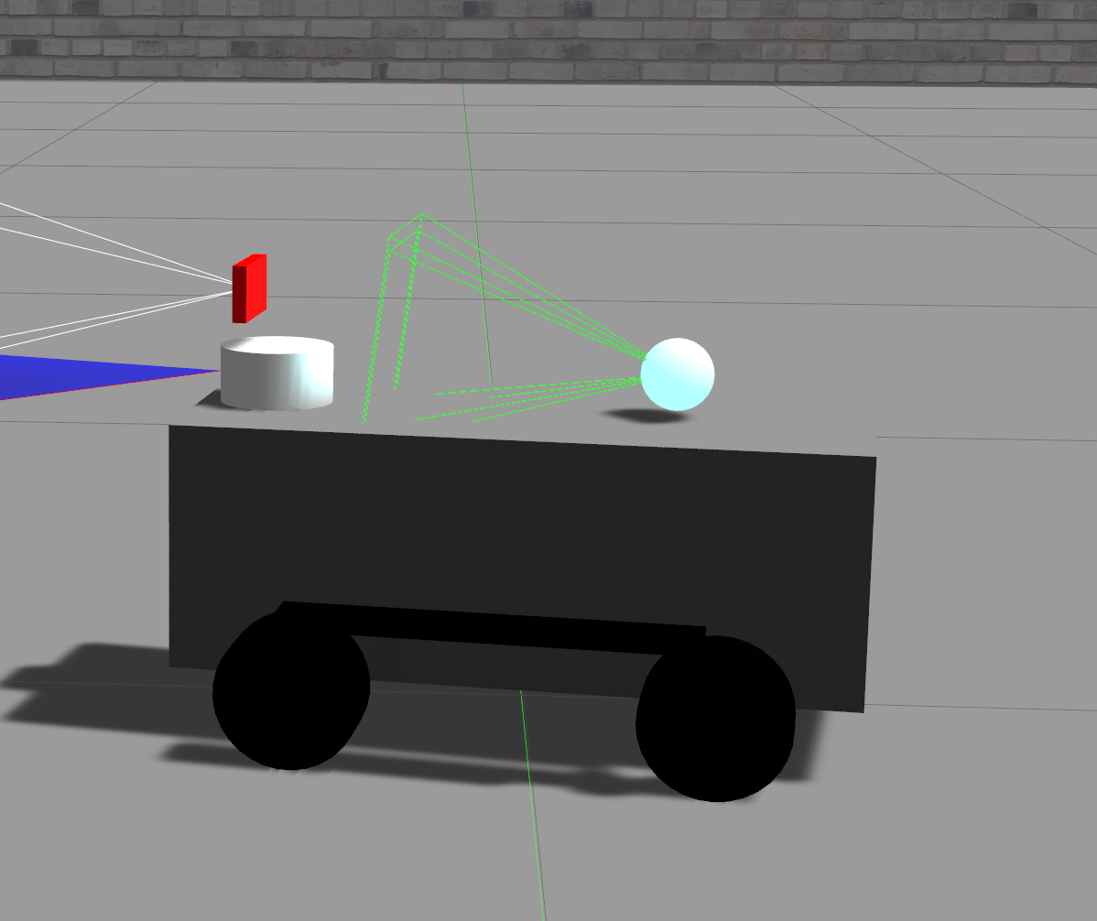
How we did It:
Connecting Pixy Cam to MBot
Control Program
Exploration
Object recognition
Beeping
Simulator
Build environment
Update robot to match functionality
Led light plugin added on top
Camera
LED
Notes:
Mar - PixyCam
Jenny - Simulator
Karan - LED Lights
Jenny - Control Program Sim Mar - Control Program Physical

Slide 8
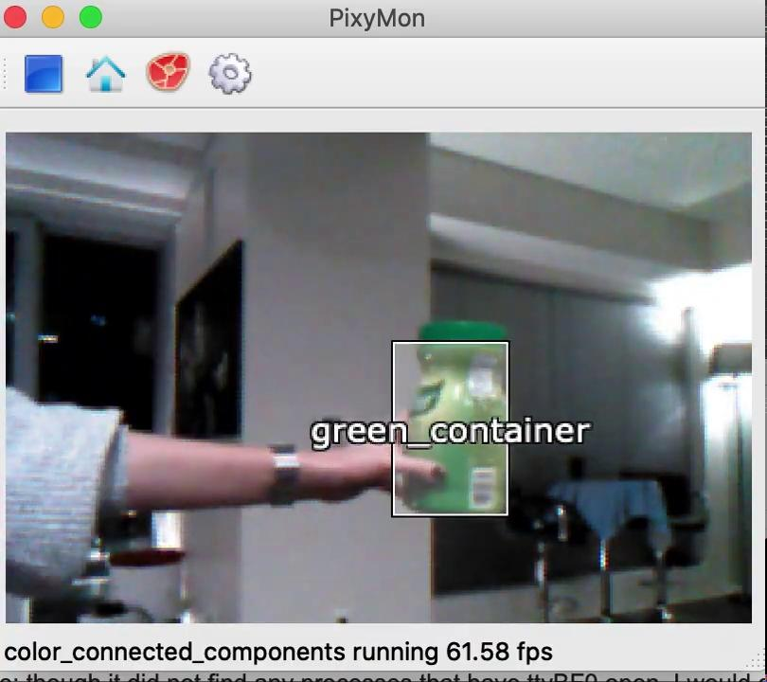
Interesting Components
Connecting the Pixy cam functionality with the robot for object detection and alert system
Alert system was cool because it could make this robot useful for those who cannot see well
Connecting the two required rj25 to Dupont wire, had to manually connect pins to PixyCam’s I/O board
To get data from the PixyCam we used I2C interface
Notes:
Mar

Slide 9

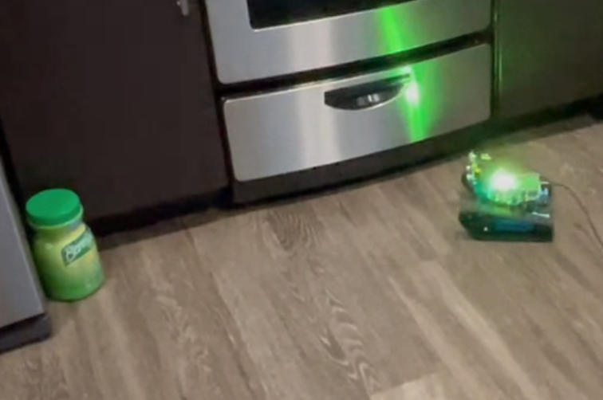
Interesting Components
Map Coloring
Labeling locations
Spots can be red, orange, brown, blue, yellow, green
Connecting with LED colors
Color that shows up on the map is the color the LED lights up as well
When the color diminished on the map the color is made to dim on the LED.
Notes:
Jenny - Map Coloring
Karan - LED lights

Slide 10
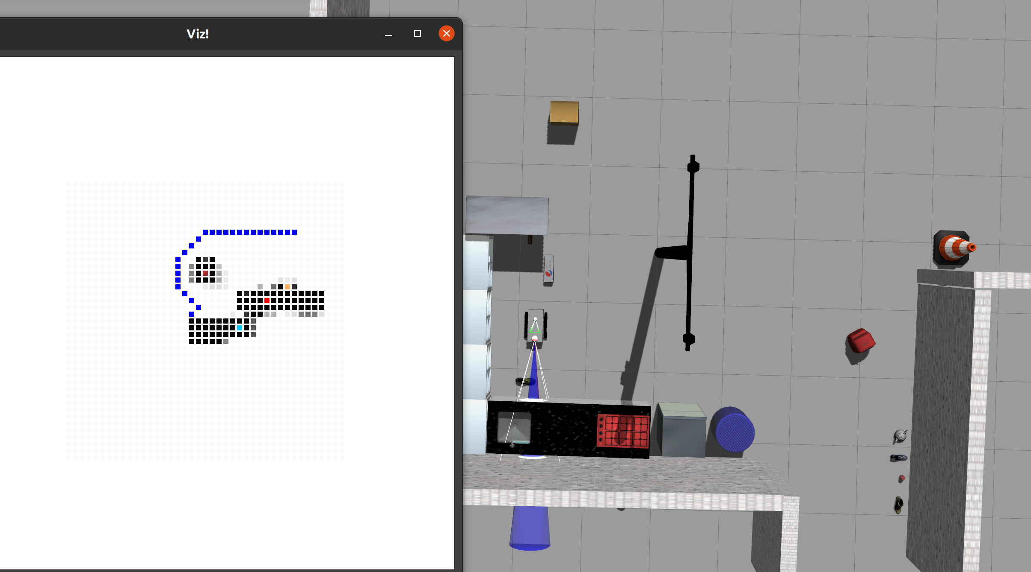
Sim Output - Map Coloring
Here you can see the labeled objects in their color and the path to follow
Notes:
Jenny

Slide 11
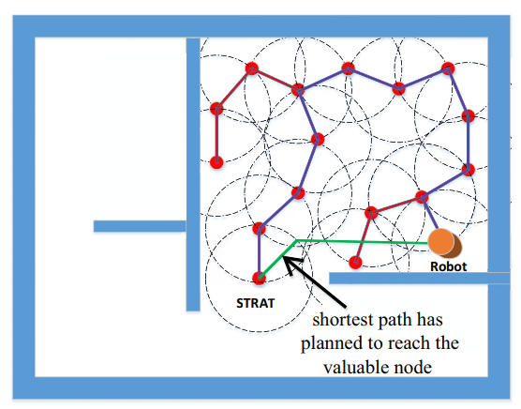
Academic Paper
Improved Backtracking Algorithm for Random Tree Exploration
Creates a tree that represents the exploration path the robot should take
Path is only appended to if node is safe
Improved = go back to valuable node using shortest path rather than back tracing previous steps
A*
Notes:
Jenny

Slide 12
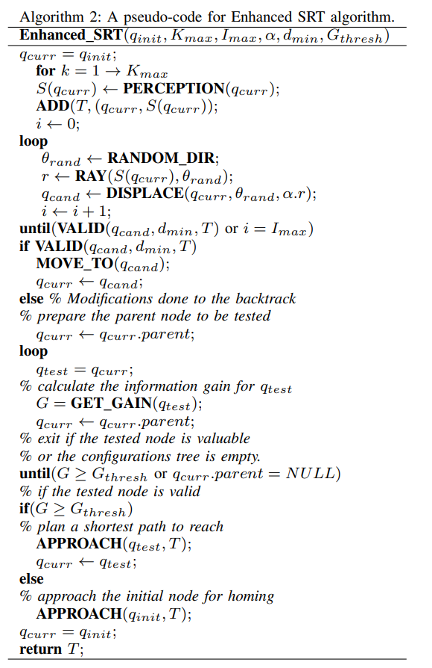
Algorithm Pseudo Code
Modifications:
Our local safe region representation was by checking neighbors hit total rather than keeping a data structure stored
Most valuable not was commonly start node since we were only working with one room the start was always valuable
Notes:
Jenny

Slide 13
Adaptation: What we had to Change
Expected:
Working with Gazebo
Had to do math to get ranger’s angle in the world
Ranger’s imperfect (x,y) location in the world, also done using math and the direction in which the robot moves
Would be helpful to have side ultrasonic sensors to do wall following
Notes:
Mar

Slide 14
Adaptation: What we had to Change
Unexpected:
Communication between Mbot Ranger and Mac OS was harder than expected
Creating the LED plugin - very little documentation
Robot batteries do not last long which elongates testing times
Hard to map the desired object with mbot as there might be a mismatch between the hit of the ultrasonic sensor and PixyCam showing it identified the object

Slide 15

Robot Flying Away

Slide 16
Demo
Demoed step by step before final demo
Labeling
Moving around
Labeling and moving
Mapping
End result was moving, labeling, and mapping demo!
Notes:
Mar

Slide 17
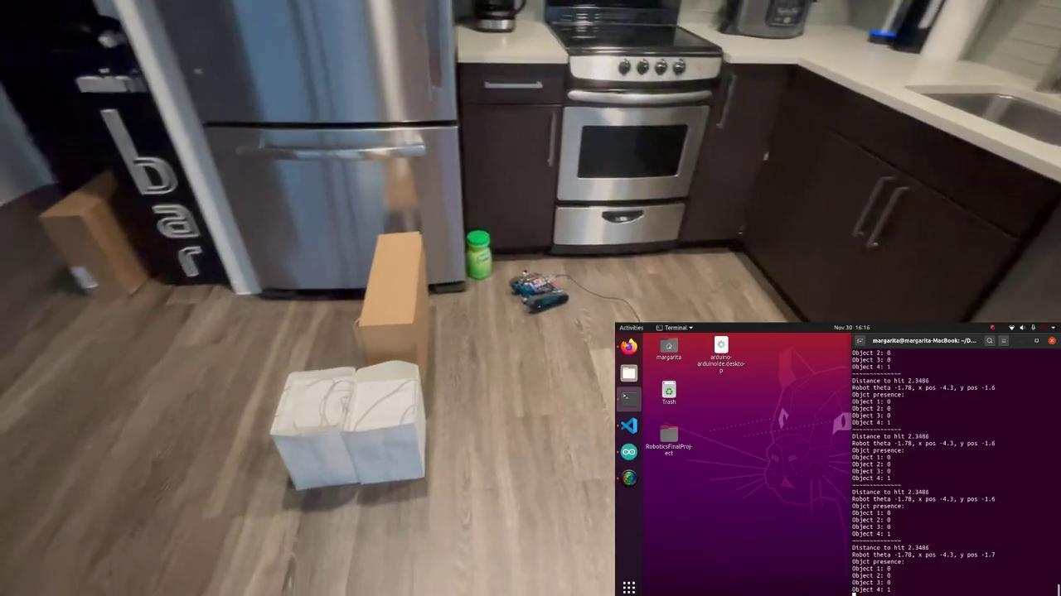
Demo Video
Short Video of the Sim to see labeling in action
MBot Ranger Demo
Notes:
Mar

Slide 18
References
“Improved Backtracking Algorithm for Efficient Sensor-based Random Tree Exploration”,
Haitham El-Hussieny, Samy F. M. Assal and Mohamed Abdellatif
For more information: https://github.com/ribeiro-je/RoboticsFinalProject
Notes:
Karan

Slide 19
Thank you for watching!
Notes:
Karan

